Slide 1
OGC API - Tiles draft specification

Slide 2
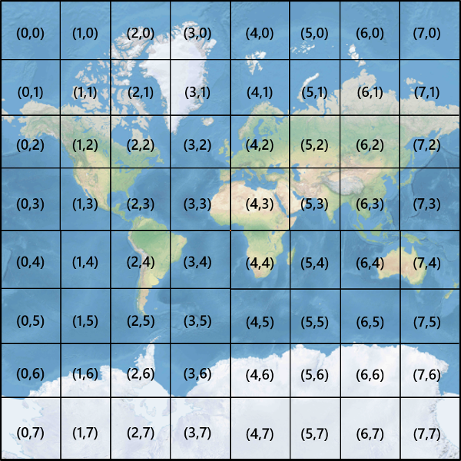
An API to retrieve tiles.

Slide 3
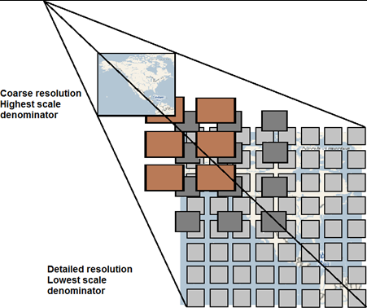
Based on the WMTS legacy
Tile Matrix Set
Tile URI templates
http://www.maps.bob/etopo2/default/‌ {TileMatrixSet}/{TileMatrix}/{TileRow}/ {TileCol}.png
{TileMatrixSet}=WholeWorld_CRS_84
{TileMatrix}=10m
{TileRow}=1 and {TileCol}=3
http://www.maps.bob/etopo2/default/ WholeWorld_CRS_84/10m/1/3.png

Slide 4
Modular standards we have
OGC API Tiles
Part 1, Part 2…
OGC API Maps Part 1 Core
OGC API Common Collections
Two Dimensional Tile Matrix Set
17-083r2
Common Tile Matrix Set
In the Definition Servers
OGC API Common Core
Core tiling conceptual and logical model
19-014r1

Slide 5
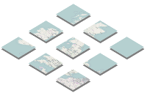
Resources
Tile Matrix Set
Tiles description (or a Tile Set description)
Tile Matrix Set Link
Tile Matrix Set Limits
Links
Tile (templated)
Sources
Tile
Coarse resolution Highest scale denominator
Detailed resolution Lowest scale denominator
TopLeftCorner
TileMatrixMinX
TileMatrixMaxX
TileMatrixMaxY
0,0
1,0
...
MatrixWidth-1,0
0,1
1,1
minTileCol‌minTileRow
...
MatrixWidth-1,1
2,2
5,4
TileMatrixMinY
0, MatrixHeight-1
maxTileCol‌maxTileRow
...
MatrixWidth-1, ‌MatrixHeight-1

Slide 6
Where the tiles come from?
Know resources
I do not know
Connected to data access resources
\collections\{collectionId}\tiles\...
Root tiles
\tiles\...

Slide 7
How many data resources?
One
More
Known
\collections\{collectionId}\tiles\...
Unknown
\tiles\...
Known
\tiles\...
Links to source data resources
Unknown
\tiles\...

Slide 8
Tile Types
Vector tiles ✓
Coverage tiles ?
Map tiles
Based on features
Respond GeoJSON or MB tiles
Client side styles
Based on coverages
Respond GeoTIFF, netCDF or UTFGrid
Client side styles
Based on maps created from other resources
Respond JPEG or PNG (or SVG)
Server side styles

Slide 9
Tile Types
Vector tiles ✓
Coverage tiles ?
Map tiles
On top of OGC API Features v1
Future:
On top of OGC API Common
On top of OGC API Coverages
On top of OGC API Common
On top of OGC API Maps core
On top of OGC API Common
Combining a resource with a style to get a map that is later cut into tiles

Slide 10
Extension or building block
An extension depends on another standard(s)
A building block is used with other standards in implementations
OGC API Tiles Core is written in a way that
can be a building block of the current OGC API Features or
can be used in conjunction with OWS Common in an implementation
OGC API Extensions will continue this approach.

Slide 11
Core and extensions
Core
Extensions
Only one geospatial resource
Support for predefined Tile Matrix Sets
TileJSON (only WebMercatorQuad)
8 defined in 17-083r2
No TileMatrixSet definition
No featureInfo
Can only retrieve one tile at a time
(No information about updates)
More that one geospatial resource
Other TileMatrixSets
Info (featureInfo)more than one)
Multi-tile (retrieve a ZIP with many tiles)

Slide 12
Parts of the OGC API maps and tiles
Tiles Part 4: multi-tile
Vector Tiles
Map Tiles
Map
Tiles collections
Multi-tile
Maps Part 2: bbox maps
Tiles Part 3: info
Maps Info
Tiles Multi-tile
Tiles info
Maps BBox
Tiles Part 1: core
Maps Part 1: core
Tiles collections
Maps collections
Maps StyleId
Features core
Tiles Part 2:
more TMXS
Tiles TMXS
Tiles core
Common collections
Maps core
Common core

Slide 13
What do we need to test in this sprint
Vector tiles
Tiles created from maps adding styles
map\{styleId}\tile\{TileMatrixSet}/{TileMatrix}/{TileRow}/{TileCol}.png
Tiles in Tile Matrix Sets
other than WebMercatorQuad
other than "Quad" (no powers of 2 zoom levels)
Services combining some resources retrievable as tiles and some that are not
Tiles that has no known source (or the source cannot be retrieved)
Tiles created from more than one resource
How to link to sources
Flexibility level
Predefined combinations of sources
Free combination of sources (cache and performance issues)

Slide 14
Last version of the candidate standard
https://github.com/opengeospatial/OGC-API-Tiles
https://github.com/opengeospatial/OGC-API-Maps
https://app.swaggerhub.com/apis/UAB-CREAF/ogc-api-tiles-opf-xmp-vt-more-1-collection/1.0.0
https://app.swaggerhub.com/apis/UAB-CREAF/ogc-api-map-tiles-opf-xmp-mt-more-1-collection/1.0.0
Vector Tiles v2 Deliverables

